Slide 1
Project Module Management System
GRADE MASTER

Slide 2
Introduction
Grade Master, Is a Project Module Management System web application designed to streamline project management and assessment processes for various specializations. This platform simplifies tasks for all involved parties - project coordinators, examiners, supervisors, and students – by offering secure, scalable, user-friendly, and high-performing features for recording marks, scheduling presentations, and managing reports to manage the year long project.

Slide 3
Functions of the team members
Name | Function
Weerasinghe K.D.E.I. (Leader) | Project Coordinator
De Silva K.H.P.N. | Project Member Examiner
Wickrama W.L.M.N. | Supervisor Co-Supervisor
Rahubadda I.P. | Student

Slide 4
Project Coordinator
Access to all functionalities.
Granting permission to students to view marks.
Assigning project members for scheduling and rubric creation.
Viewing and editing rights for mark sheets.
Adding and managing assessments.
Searching for groups and retrieving marks.
Creating marking rubrics.

Slide 5
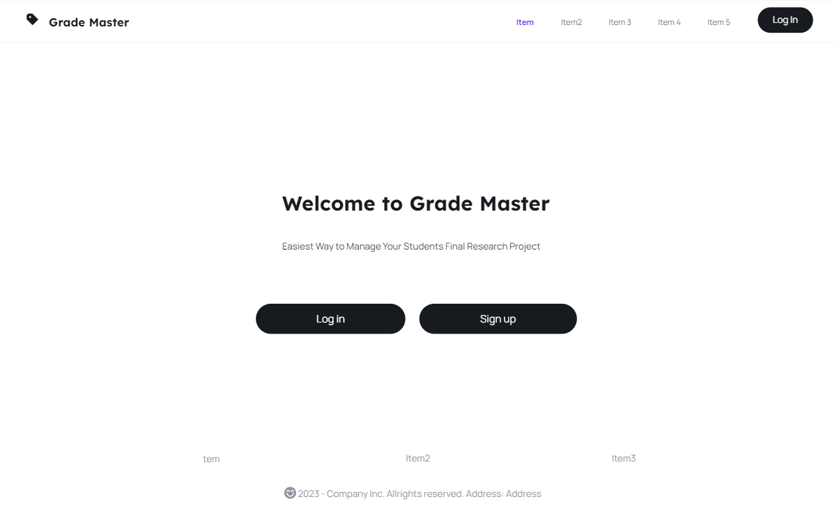
Project Coordinator user Interfaces Home-Page

Slide 6
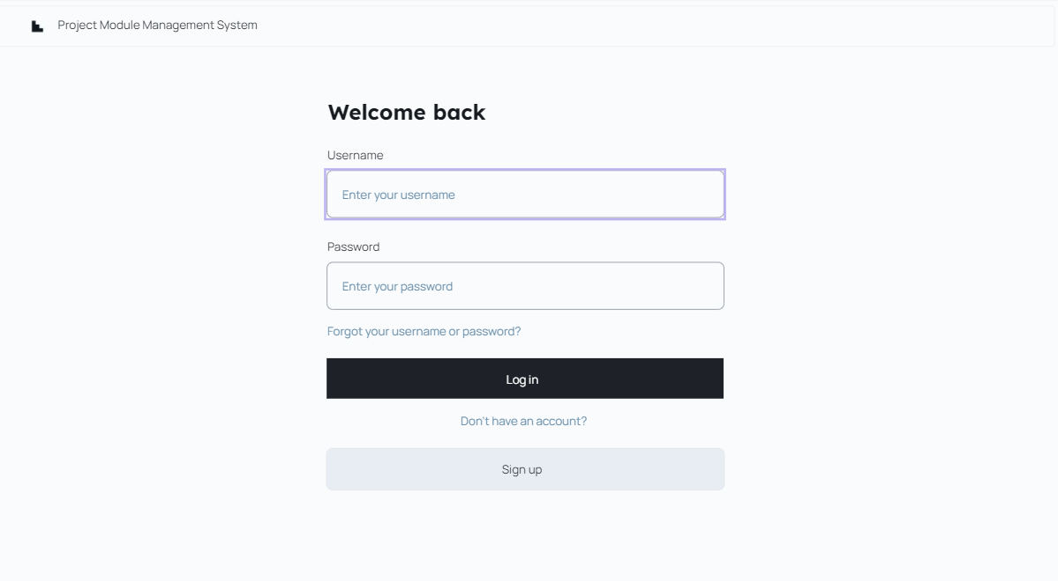
Project Coordinator user Interfaces Login-Page

Slide 7
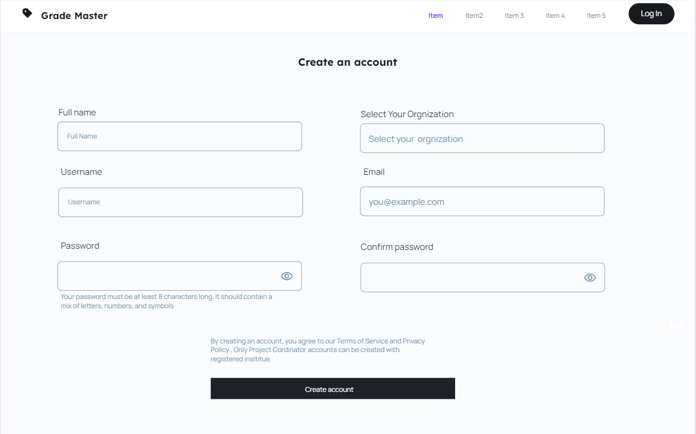
Project Coordinator user Interfaces registration-Page

Slide 8
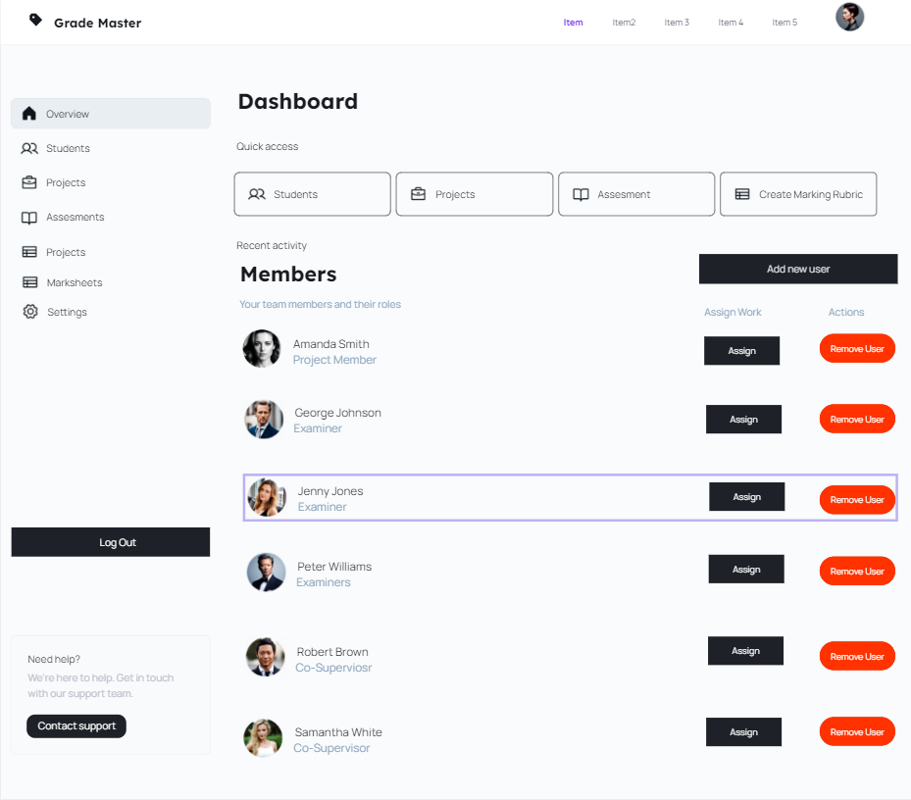
Project Coordinator user Interfaces Dashboard

Slide 9
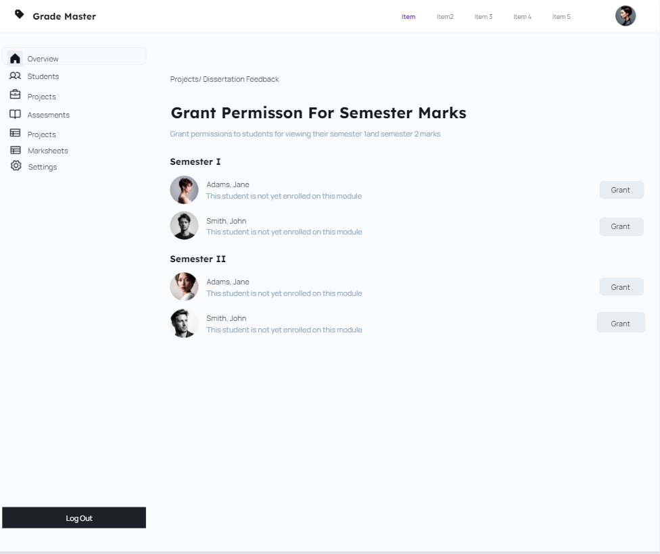
Project Coordinator user Interfaces Grant permission for Semester mark

Slide 10
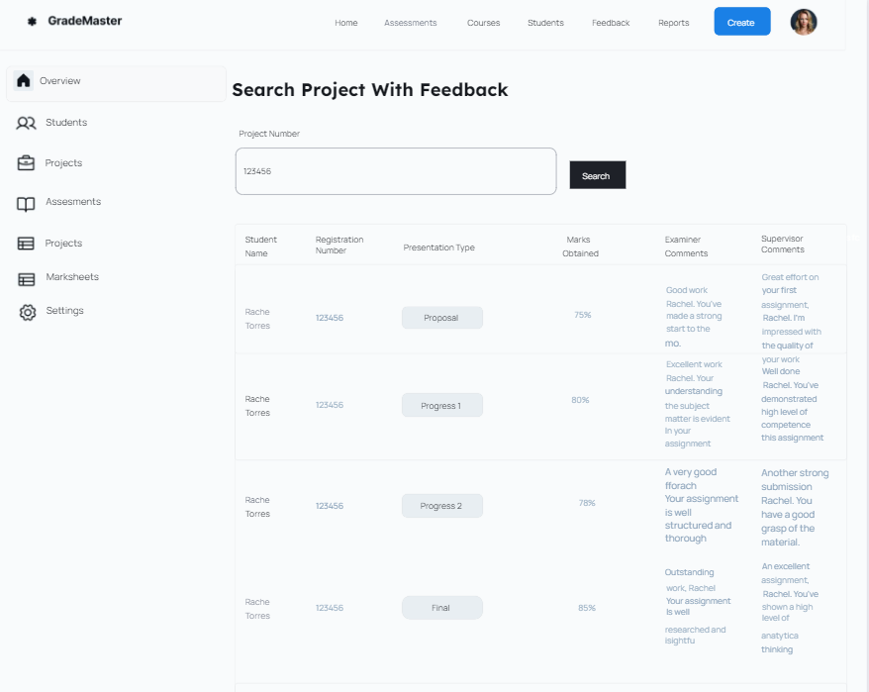
Project Coordinator user Interfaces Search by project

Slide 11
Project Members
Creating presentation schedules.
Forming presentation panels.
Creating marking rubrics.
Adding and managing assessments.

Slide 12
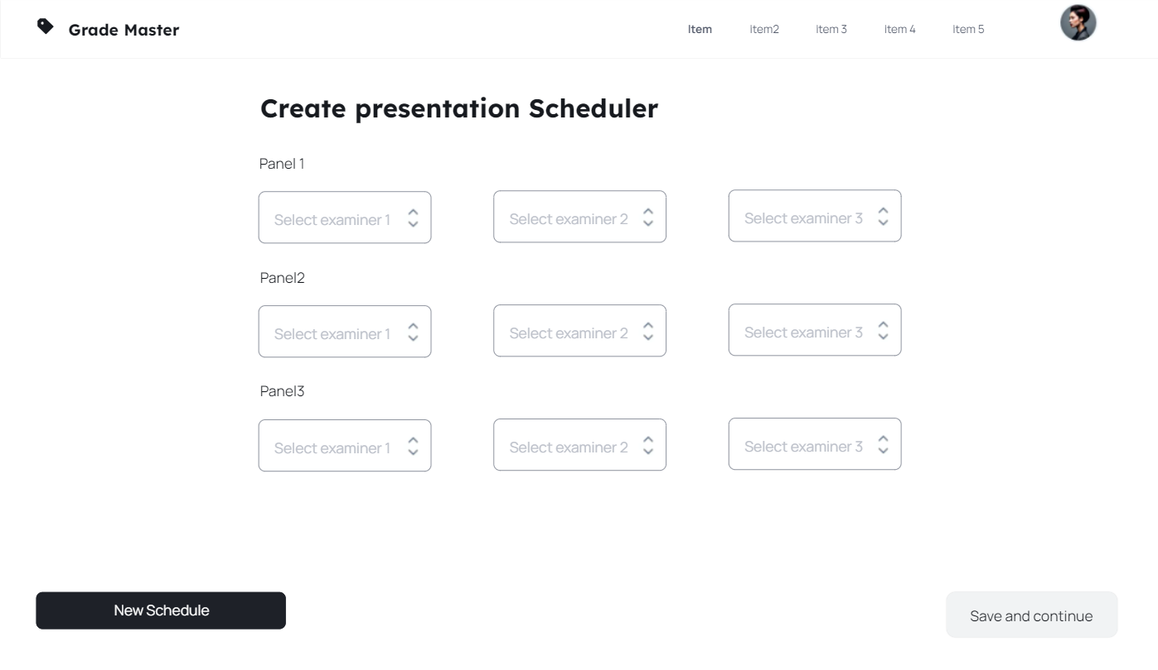
Project Members user Interfaces Presentation Scheduler

Slide 13
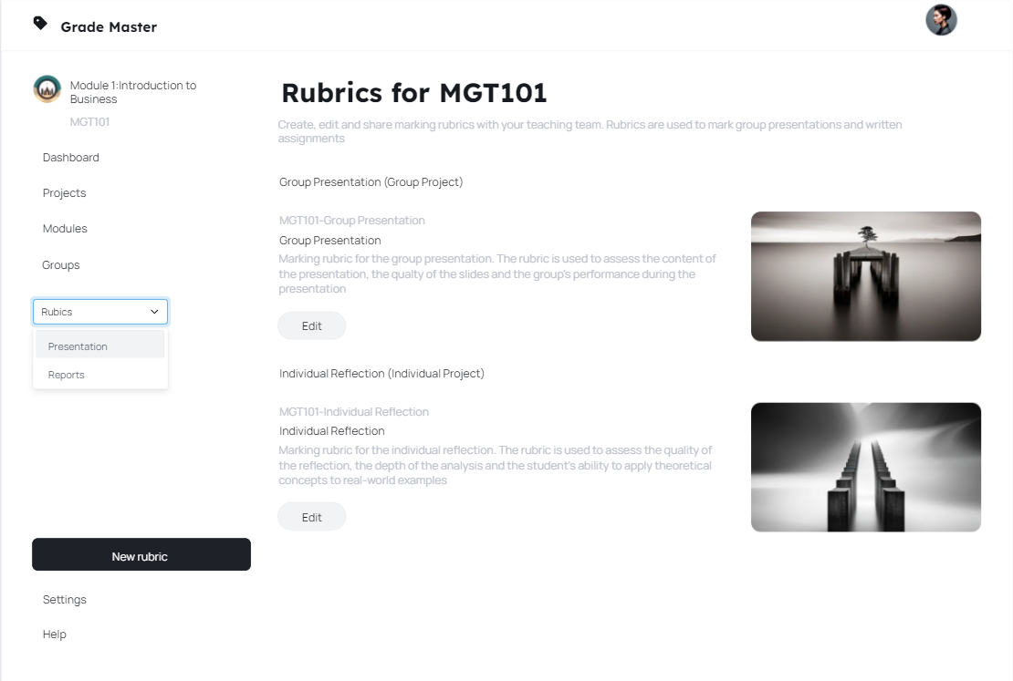
Project Members user Interfaces Rubric creation for presentation

Slide 14
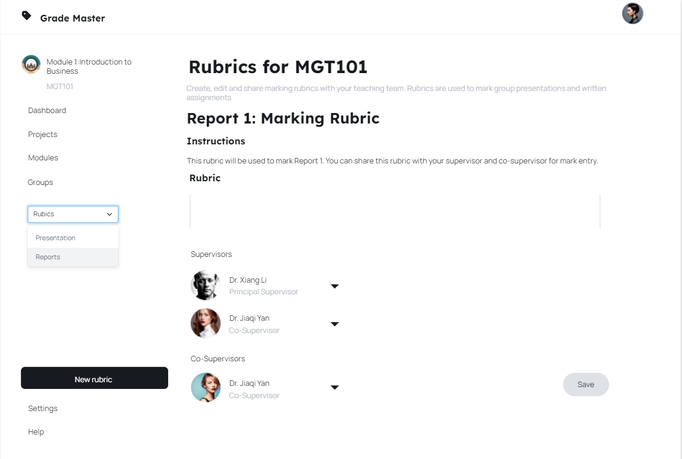
Project Members user Interfaces Rubrics creation for reports

Slide 15
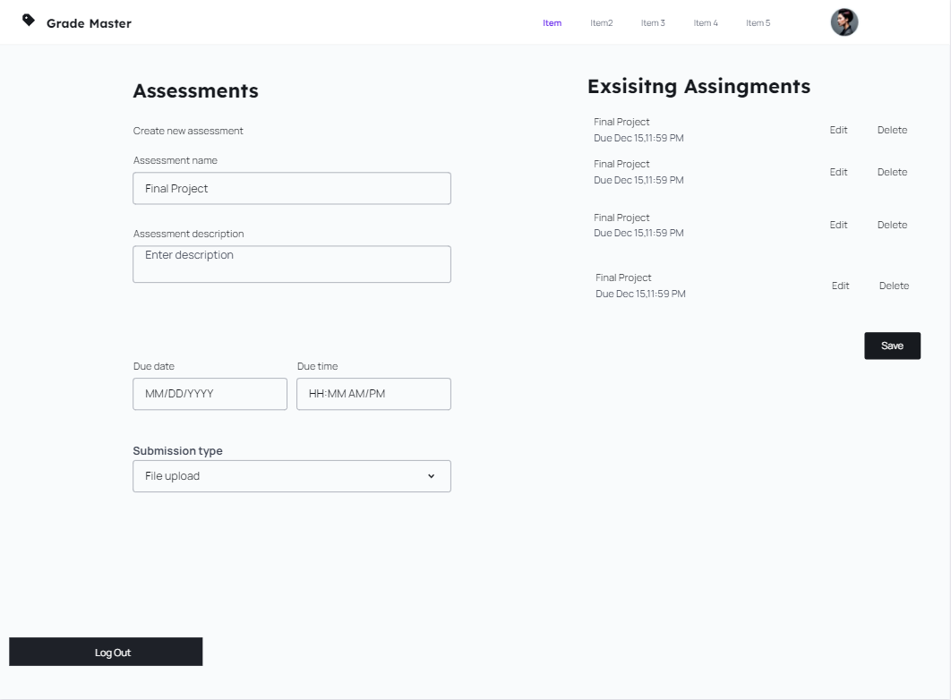
Project Members user Interfaces Add new assessments to the system

Slide 16
Examiners
Entering marks for presentations.
Searching for group marks.

Slide 17
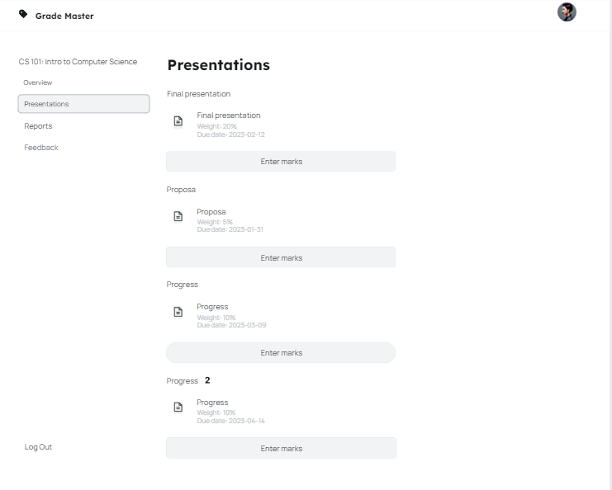
Examiners user Interfaces Marks Entry for Presentations

Slide 18
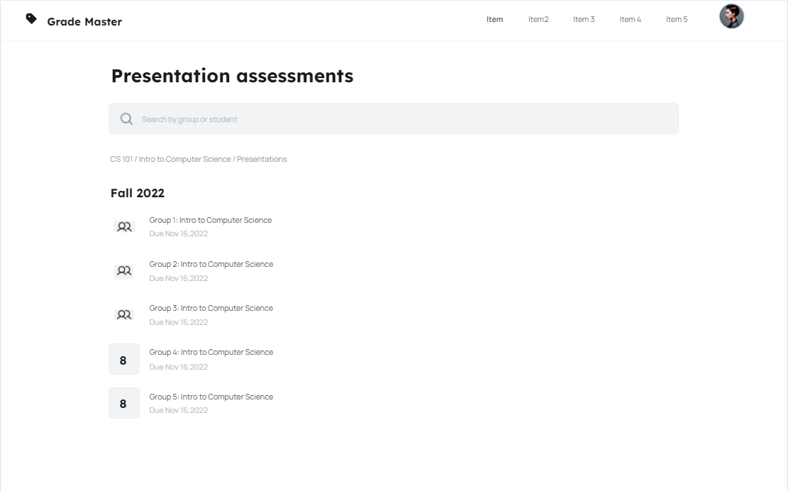
Examiners user Interfaces Marks Search for Groups

Slide 19
Supervisors and Co-supervisors
Entering marks for reports.
Searching for projects.
Providing marks for specific reports.

Slide 20
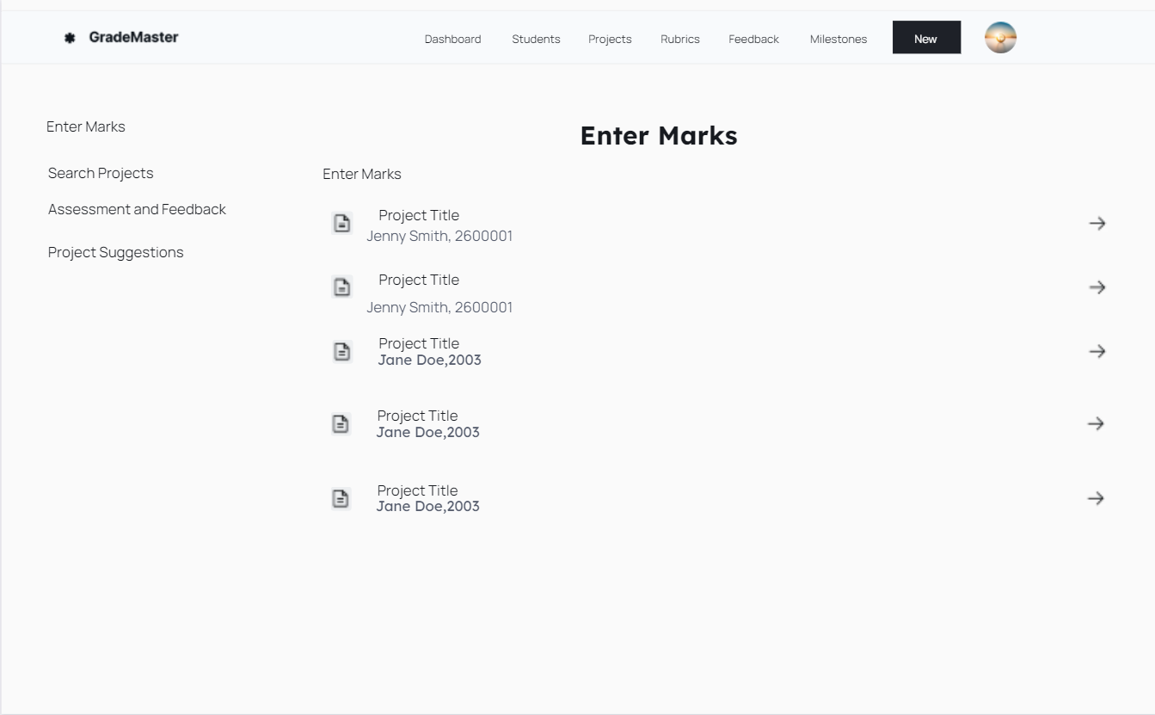
Project Supervisor user Interfaces Marks Entry for Reports by Supervisors

Slide 21
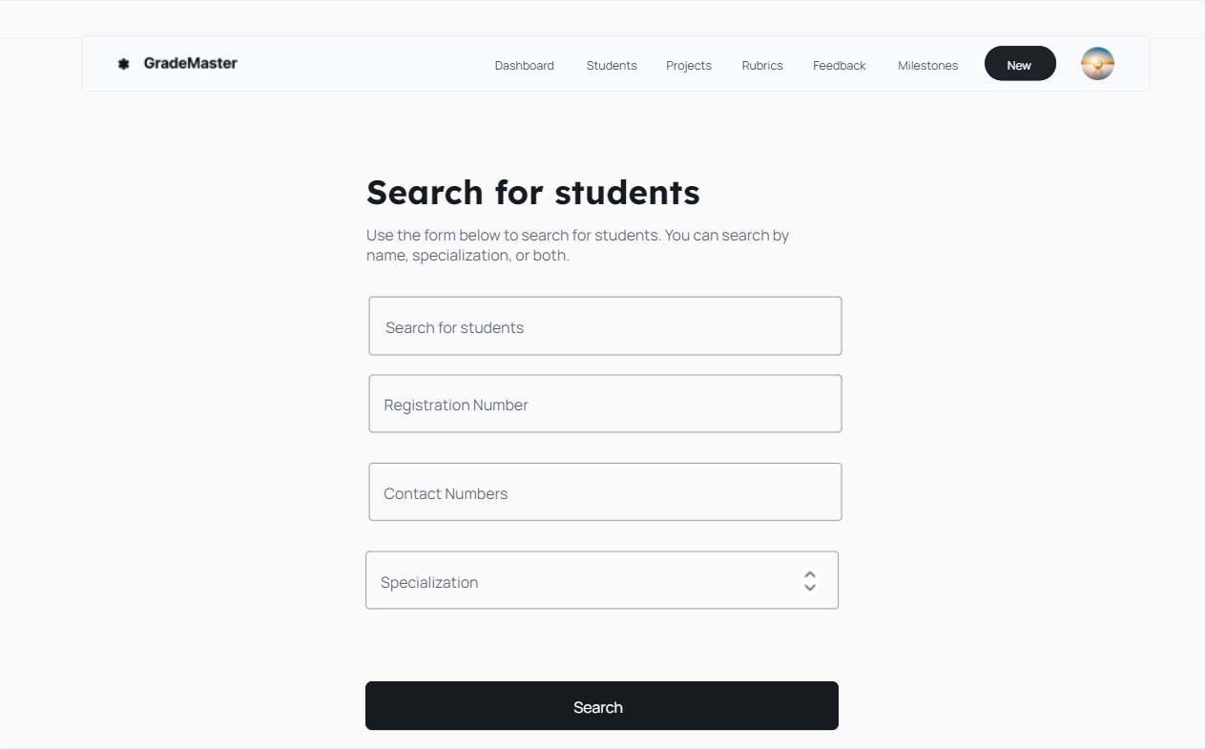
Project Supervisor user Interfaces search students by Co-Supervisors

Slide 22
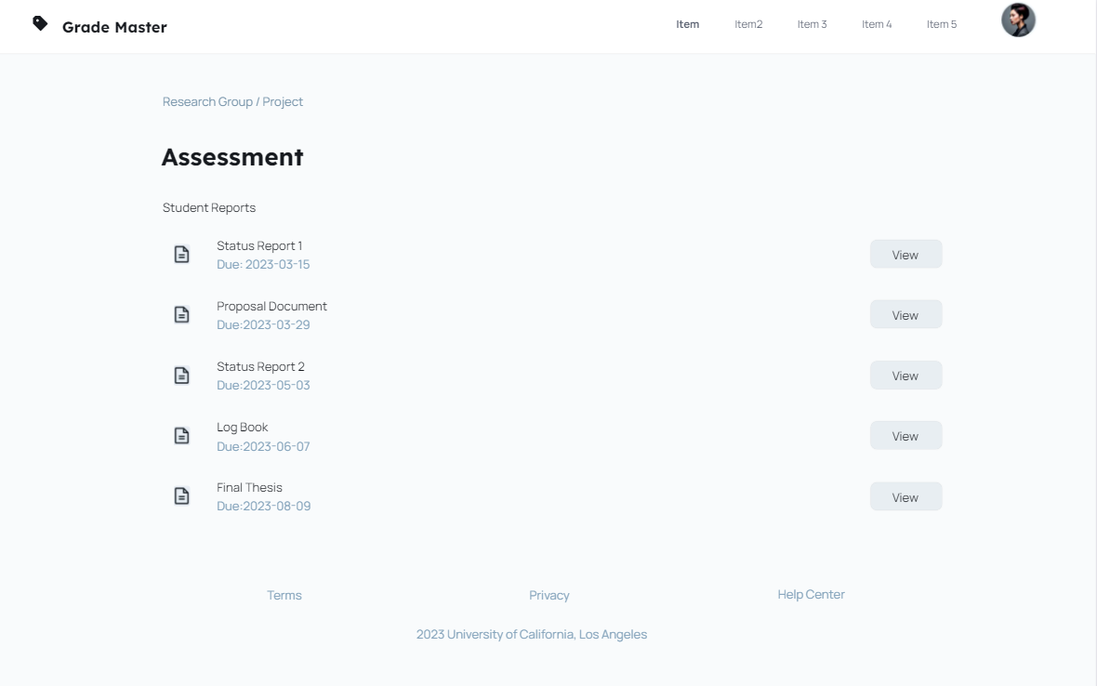
Project Supervisor user Interfaces Supervisor Report Assessment Interface

Slide 23
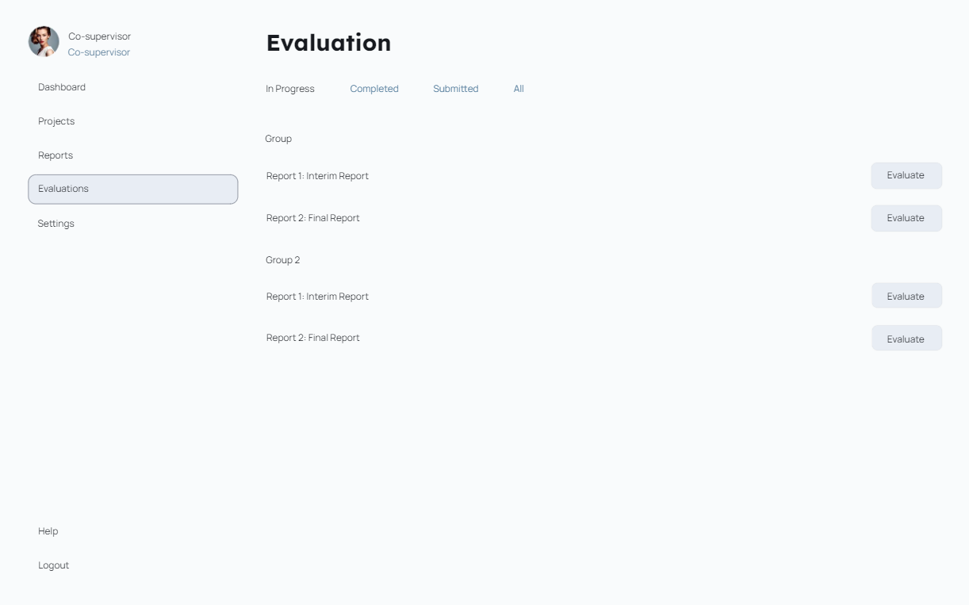
Project Supervisor user Interfaces Co-Supervisor Report Assessment Interface

Slide 24
Students
Registering project groups.
Entering research paper publication details.
Viewing marks in each semester based on permissions.

Slide 25
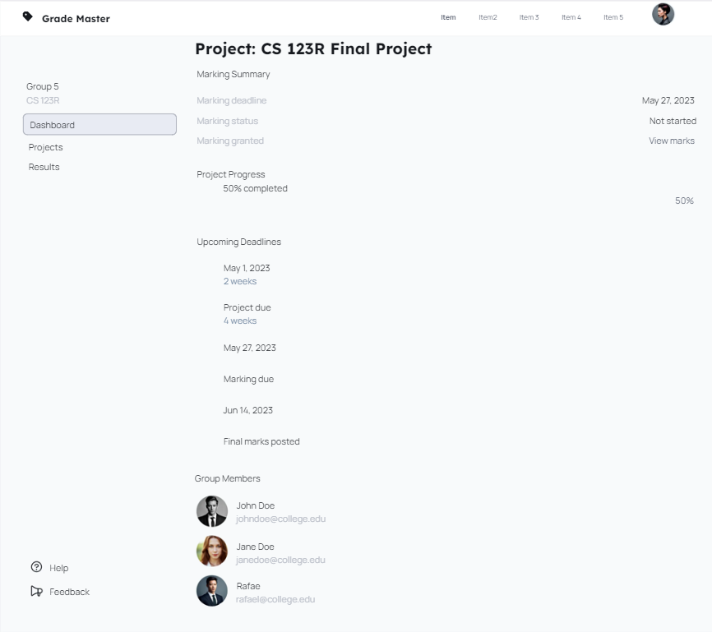
student user Interfaces student dashboard

Slide 26
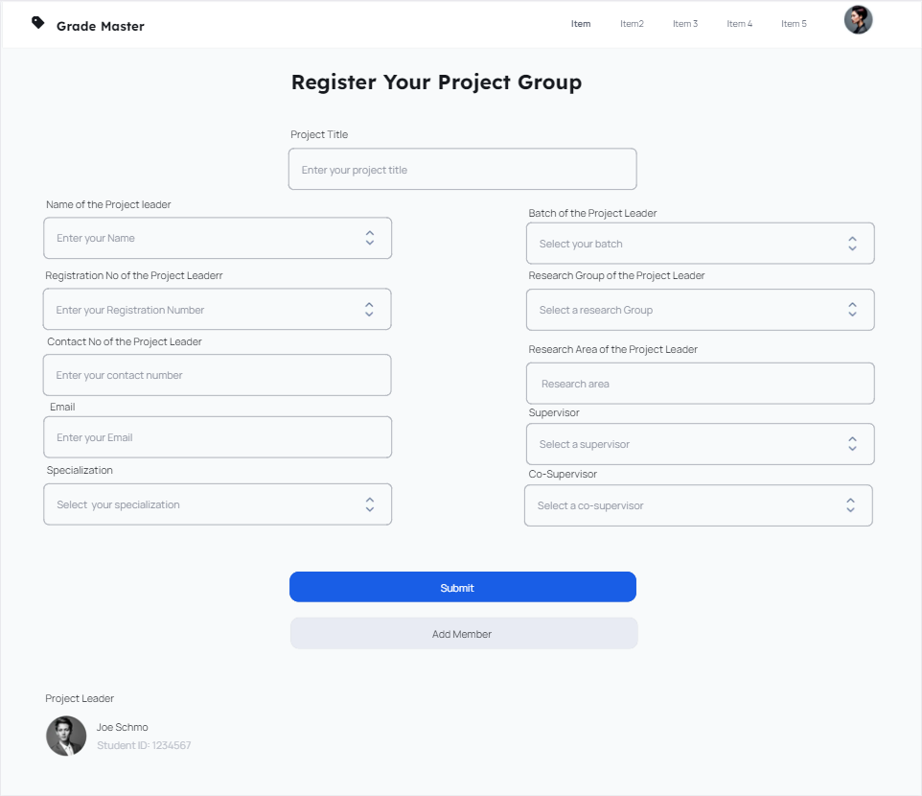
student user Interfaces Registering project groups

Slide 27
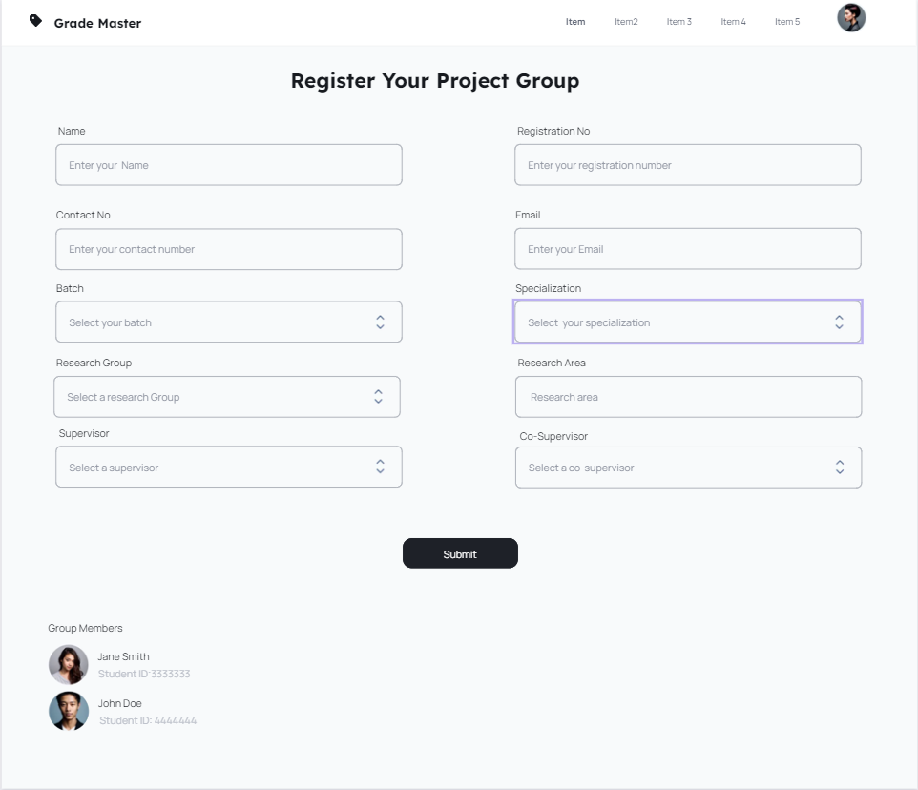
student user Interfaces Registering project groups

Slide 28
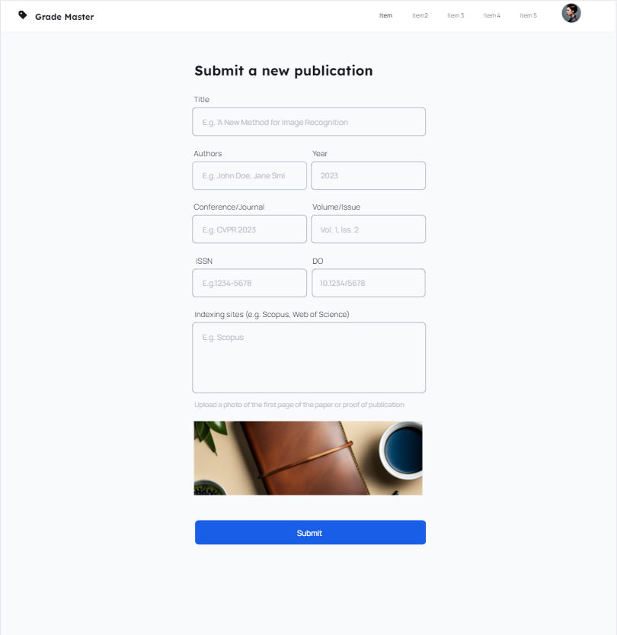
student user Interfaces research publication

Slide 29
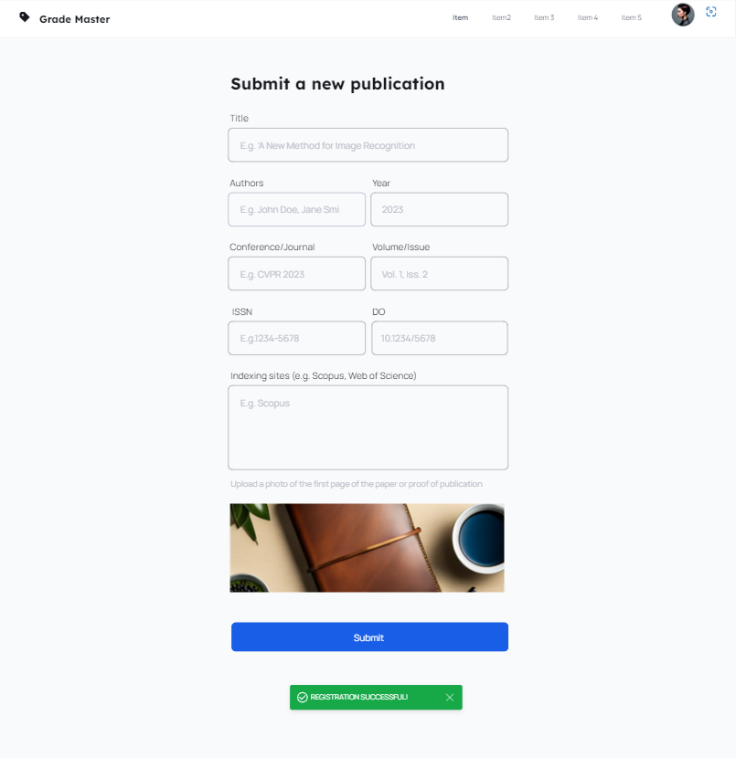
student user Interfaces research publication

Slide 30
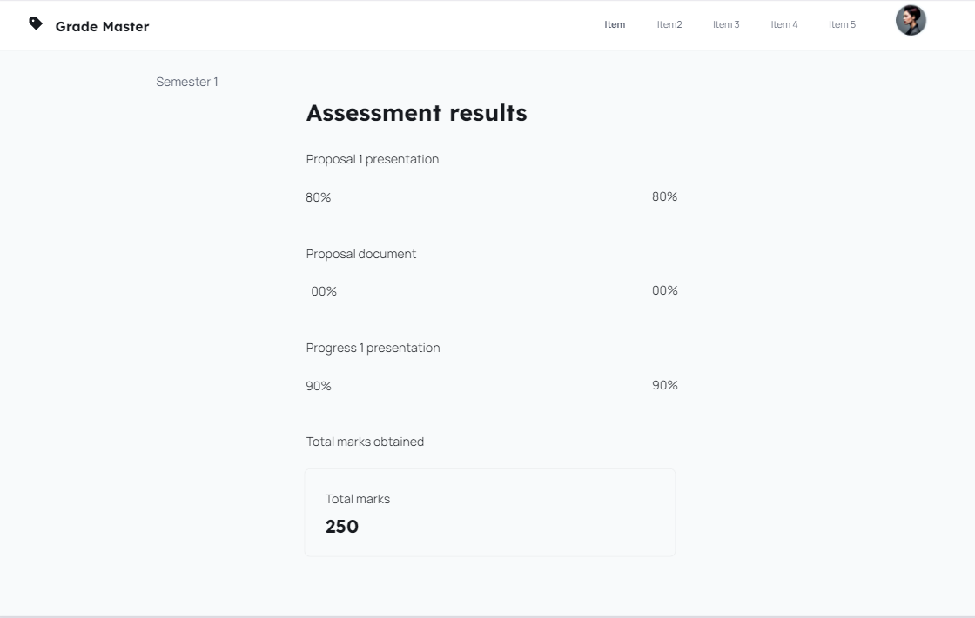
student user Interfaces View marks semester 1

Slide 31
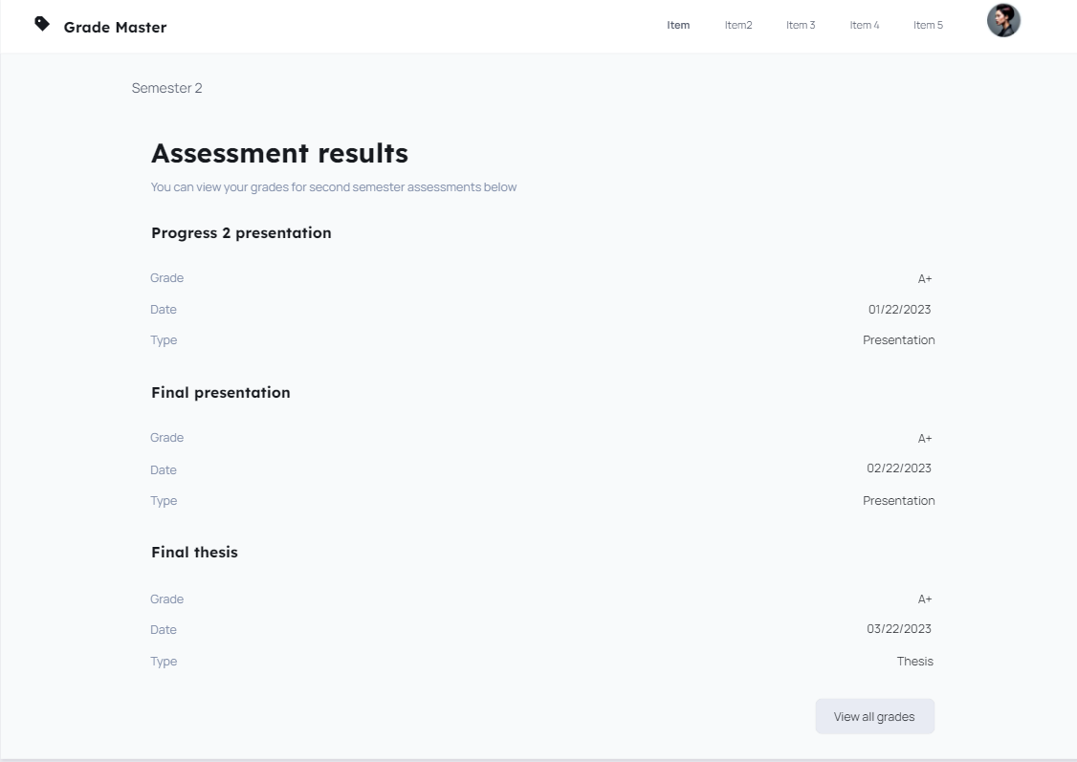
student user Interfaces View marks semester 2

Slide 32
Research Paper Publication
System scanning and verification.
Restrictions on data entry

Slide 33
Mark Sheet Generation
Comprehensive mark sheet.
Filtering options for the coordinator.
Comparison with previous year's data.

Slide 34
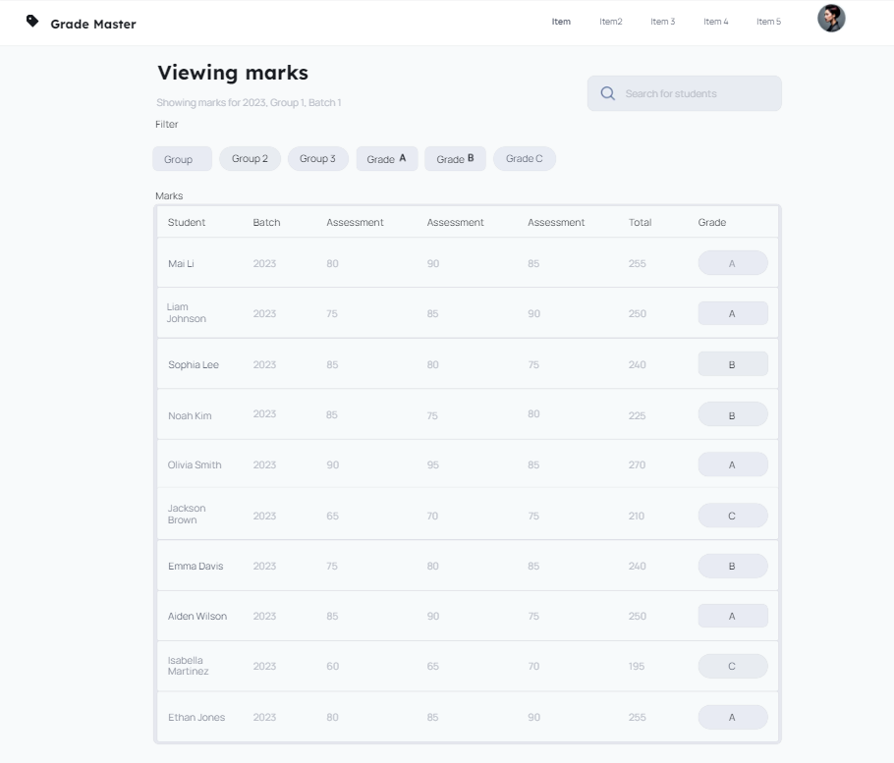
student user Interfaces research publication

Slide 35
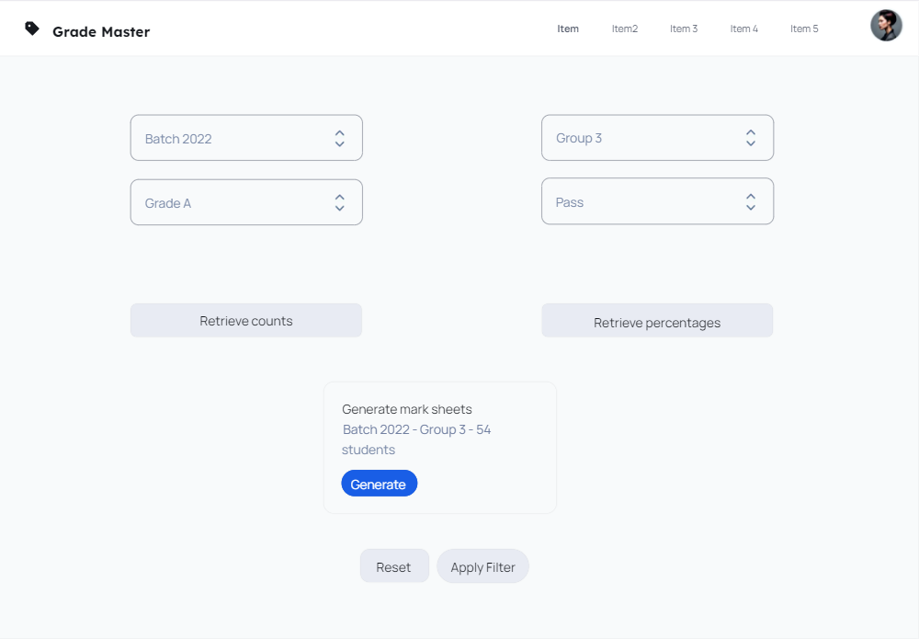
student user Interfaces research publication

Slide 36
Non-Functional Requirements
Security measures: Role-based access, secure authentication.
Scalability considerations: System designed for growth.
Usability features: Intuitive user interface.
Performance optimization: Efficient handling of simultaneous activities

Slide 37
Thank you
GRADE MASTER

